Slide 1
ENTSO-E Extensions – status after WG13 meeting in Nuremberg
IOP call, 20 Feb 2012
Chavdar Ivanov, PhD
Research and Development Senior Advisor, ENTSO-E Secretariat

Slide 2
    TSO feedback on using ENTSO-E profile for frequent exchange
Day-Ahead Congestion Forecasts (DACF) is a frequent exchange - up to 24 models on daily basis (legal minimum is set to 6 as of now)
  Benefit of using CIM for such process:
    Exchange of only a single MAS
    Separation in EQ/TP/SV files
    No aggregation of equipments in EQ
    Exchange of resulting topology in a simple way in TP
    Exchanges of results in SV

Slide 3
TSO feedback on using ENTSO-E profile for frequent exchange - Focus on benefits of TP partition
Exchange of resulting topology in a simple way in TP:
  Use of TopologicalNode class
  e.g: timestamp 09:30 →→→ timestamp 10:30
  In general, TSOs are not interested in exchanging complex internal substation topologies…
  … But only the results of the topology processing for a given model and timestamp
ACLineSegment
Terminal
Terminal
ACLineSegment
ACLineSegment
Terminal
Terminal
ACLineSegment
TopologicalNode
ACLineSegment
TopologicalNode
ACLineSegment
ACLineSegment
ACLineSegment
TopologicalNode
Terminal
Terminal
Terminal
Terminal
VoltageLevel
VoltageLevel

Slide 4
Focus on EQ/TP/SV partition issue – change in 452, 456
EQ/TP/SV: from Theory to Practice
  In the process of DACF models generation, EQ files are very much similar for consecutive hours…
  … But there are very recurring differences
  CurrentLimit.value
  RegulatingControl.value
  Between different hours, real-time system operators use:
    Different sets of CurrentLimit.value
    Different sets of SynchronousMachine RegulatingControl.targetValue
    And sometimes even different sets of RegulatingControl.mode (from Voltage to ReactivePower mode for eg.)

Slide 5
Focus on EQ/TP/SV partition issue – change in 452, 456
  As a result, the theoretical partition in EQ/TP/SV can never be used and EQ has always to be sent for each timestamp of the day
  To be able to benefit of the advantages of EQ/TP/SV partition:
    RegulatingControl.targetValue and mode
    OperationalLimit.value
  Should be moved out of the EQ set
  ENTSO-E IOP Call – 20 Feb 2012 – It is OK for IOP participants

Slide 6
ENTSO-E extensions
Classes and attributes that were necessary for IOP, but not added to CIM UML15v31 (no time; just before freezing of CIM15), were added to UML as ENTSO-E extensions
This was done to allow:
Testing in the IOP
To be easy to identify the differences between ENTSO-E profile and IEC CIM
ENTSO-E extensions are mainly on short circuit part
Summary
1 class
2 enumerations
Additional attributes to 9 existing classes
Additional attributes to 2 existing enumerations
Notes:
6

Slide 7
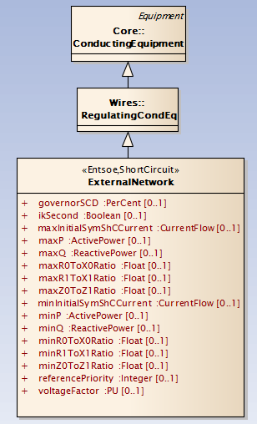
ENTSO-E extensions
The new class
This class represents external network and it is used for IEC 60909 calculations.
WG13 questions/agreement:
- Why is this defined as a subtype of RegulatingCondEq? – Because connection to a external grid that can have slack node (in most of the cases the ExternalNetwork is the slack); ExternalNetwork stands on its own – not part of reduction of a portion of a grid.
- Was originally modeled as EquivalentInjection. Why was this changed? EquivalentInjection is coming from grid reduction; this is not the same for ExternalNetwork
- Attribute voltageFactor is of type PU. Why was this necessary? Could this be changed to PerCent? This needs to be clearly explained in the description. We need to check the description and IEC 60909
- Agreed to add the attributes from ExternalNetwork to EquivalentInjection. IOP participants insist to have the ExternalNetwork as a separate class as initially suggested
- Do we need to add Short Circuit specific attributes for minP and maxP? We assume that an extra set is not necessary. – If we have separate classes we don’t have this issue
Notes:
7

Slide 8
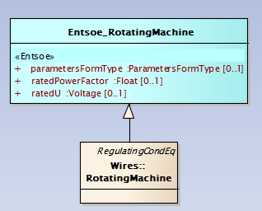
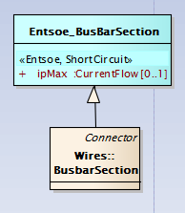
ENTSO-E extensions
Additional attributes to RotatingMachine: parametersFormType used for Dynamics
WG13 conclusion – see next slide
Additional attribute to BusbarSection
WG13 conclusion:
Agree to add ipMax
Notes:
8

Slide 9
ENTSO-E extensions
WG13 discussion/conclusion on RotatingMachine:
parameterFormsType needs a description
Data type ParameterFormsType needs to be moved out of Dynamics package into Domain
Can we replace the cross package inheritance (GenSync, GenAsync, MotorSync, and MotorAsync inheritinf from RotatingMachine) with inheritance from a new class (RotatingMachineDynamics) in the Dynamics package?
Is cross package inheritance more of a problem than maintaining two different classes that are associated?
Agree to add ratedPowerFactor and ratedU to RotatingMachine. Need to remove “in kV” from description of ratedU.
SynchronousMachine can behave in four different ways as 1) Synchronous Generator 2) Asynchronous Generator (wind turbines) 3) Synchronous Motor and 4) Asynchonronous Motor. Recommend adding synchronous generator attributes directly to SynchronousMachine. Use existing SynchronousMachine class for a machine that never operates asynchronously. Use AsynchronousMachine for machines that always operate asynchronously. Add a new modeling for machines that can operate synchronously or asynchronously. This recommendation will be taken to the Dynamics modeling team by Chuck, Pat and Terry.
Notes:
9

Slide 10
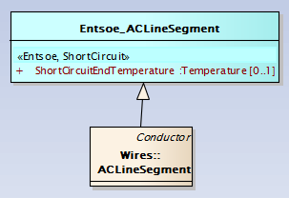
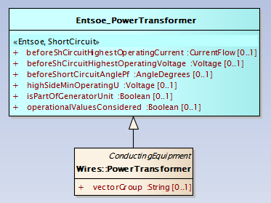
ENTSO-E extensions
Additional attribute to AcLineSegment
WG13 conclusion
Agree to add shortCircuitEndTemperature. Remove “in C” from the description.
Additional attributes to PowerTransformer
WG13 conclusion
Agree to add suggested attributes
Notes:
10

Slide 11
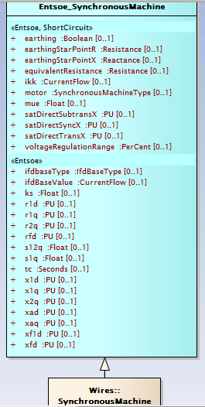
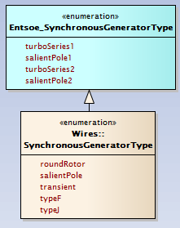
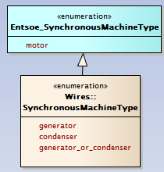
ENTSO-E extensions
Additional attributes to SynchronousMachine
Extensions of 2 enumerations
WG13 conclusion – see next slide
For dynamics – in EPRI doc, but not in UML
Notes:
11

Slide 12
ENTSO-E extensions
WG13 conclusion on: SynchronousMachine, SynchronousGeneratorType, and SynchronousMachineType
equivalentResistance – remove “in Ohms”
earthing – correct description
earthingStarPointR and X – remove “in Ohms”
motor is not meant to be a new attribute, just an extension to the existing enumeration
mue – change attribute name to “mu” - correct spelling of generator
ikk – correct spelling of generator
Attributes from “tc” on are for Dynamics – leave for Dynamics team
Agree to add attributes with the above changes
Notes:
12

Slide 13
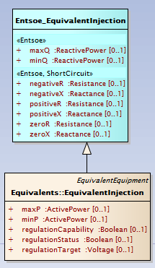
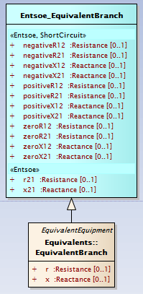
ENTSO-E extensions
Additional attributes to EquivalentInjection
WG13 conclusion
maxQ, minQ – clean up description
Change to use existing naming convention for attributes (r, r1, r2) also for X
Agree to add attributes with the above changes
Additional attributes to EquivalentBranch
WG13 conclusion
Agree to add all attributes
Notes:
13

Slide 14
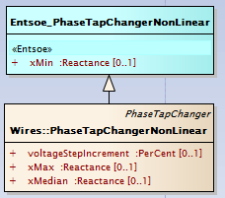
ENTSO-E extensions
Rename xMedian to xMin – agreement 7 July
PhaseTapChangerNonLinear.xMax
PhaseTapChangerNonLinear.xMin
instead of
<cim:PhaseTapChangerNonLinear.xMax>0.0001</cim:PhaseTapChangerNonLinear.xMax>
<cim:PhaseTapChangerNonLinear.xMedian>0.0001</cim:PhaseTapChangerNonLinear.xMedian>
No change now. Issue to WG 13
Note to PhaseTapChangerNonLinear in the profile: " xMedian to be considered as xMin - the reactance at the minimum tap step.“
WG13 conclusion
Agree to replace xMedian with xMin.
Check how this affects the text in 301.
Notes:
14

Slide 15
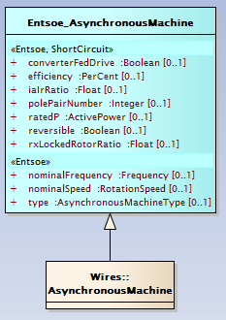

ENTSO-E extensions
Additional attributes to AsynchronousMachine
WG13 conclusion:
Attribute nominalFrequency needs more description. Nameplate data gives info if the machine is 50/60 Hz
Attribute nominalSpeed needs more description. Nameplate data. Depends on the slip and number of pole pairs.
Is “ratedP” the best name for mechanical power? Would ratedMechanicalPower be better? OK Should this be ActivePower? OK - Watts
Description of “reversible” needs to be expanded. To be checked in IEC60909
Need to add description on “type” attribute. Does this attribute conflict with the subtypes of AsynchronousMachine (GenAsync and MotorAsync)?
New enumeration: AsynchronousMachineType
WG13 conclusion
Name should be AsynchronousMachineKind
Need description on the values
Notes:
15

Slide 16
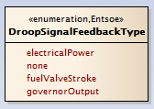
ENTSO-E extensions
New enumeration used in the Dynamics package – GovCT1 model
Notes:
16

Slide 17
ENTSO-E issues to WG13 based on the IOP July 2011
No | CIM Issues | ENTSO-E IOP Proposal
1 | Switch class | "retained" attribute should be added to 61970-452 as required. ENTSO-E profile will also use this attribute.
What is the status?
WG13 conclusion:
Agreed to expand the description to explain that flows on retained switches would normally be computed in power flow.
Agreed to make this required in 452.
Switch Status
Suggest adding SvSwitch to represent input or output status values.
Further discussion is needed.
Notes:
17

Slide 18
ENTSO-E issues to WG13 based on the IOP July 2011
No | CIM Issues | ENTSO-E IOP Proposal
2 | Missing documentation for classes in the Dynamics package | MetaBlockConSignal, MetaBlockConnection MetaBlockConnectivity,MetaBlockOutputReference MetaBlockSignal, MeetaBlockState MetaBlockStateReference, GovCT2, GovDUM, GovGASM, GovGAST, GovGAST2, GovGASTWD, GovHydro0, GovHydro2, GovHydro3, GovHydro4, GovHydroDD, GovHydroPID, GovHydroPID2, GovHydroR, GovHydroWEH, GovHydroWPID, GovRAV, GovSteamCC, GovSteamEU, GovSteamFV2, GovSteamFV3, GovSteamSGO, GovWT1P, GovWT1T, GovWT2P, GovWT2T, GovWT3P, GovWT3T, GovWT4P, GovWT4T, TLCFB1, RotatingMachine.parametersFormType CEnumeration is not used: InputSignalCodeJ; IfdBaseType
It is in the scope of CIM for Dynamics project
Notes:
18

Slide 19
ENTSO-E issues to WG13 based on the IOP July 2011
No | CIM Issues | ENTSO-E IOP Proposal
3 | Dynamics package | - All attributes names should be looked at and follow naming rules except the names of the attributes in classes for standard models - Additional classes should be added when the package is extended. These classes are representing additional standard models. The classes or their function MotorSync, ProtectiveDevice, SourceModels, StaticVarDevice should be integrated in the package.
It is in the scope of CIM for Dynamics project
Notes:
19

Slide 20
ENTSO-E issues to WG13 based on the IOP July 2011
No | CIM Issues | ENTSO-E IOP Proposal
4 | MAS in the header of SV in the assembled model | Required if the SV covers only one MAS and empty if SV covers more than one MAS.
What is the status? Was it added to 456 or other place?
WG13 conclusion:
An SV data set can be based on equipment and topology from multiple MASs. What is the MAS of the power flow solution of the combined model? A MA needs to be specified as the source for any data set exchanged.
Originally Modeling Authority was used to designate who was responsible for modeling a given portion of the network model. Now MA also applies to who created the power flow solution for the State Variable exchange. Need to figure out how we are covering these two roles.
Model Assembly could represent set of equipment, topology and state variable data.
Should this information move from the header back into the instance data?
Header definition could be moved out of 552.
Notes:
20

Slide 21
ENTSO-E issues to WG13 based on the IOP July 2011
No | CIM Issues | ENTSO-E IOP Proposal
5 | ENTSO-E extension package | All attributes, classes, etc from this package should be added to CIM16. The association ReactiveCapabilityCurve.EquivalentInjection should be added as well.
See slides on ENTSO-E extensions;
The association ReactiveCapabilityCurve.EquivalentInjection should not be forgotten
WG13 conclusion:
Agree to add association to ReactiveCapabilityCurve
Notes:
21

Slide 22
ENTSO-E issues to WG13 based on the IOP July 2011
No | CIM Issues | ENTSO-E IOP Proposal
6 | GovCT1 | The type of GovCT1.rSelect should be changed to an enumeration DroopSignalFeedbackType with enumValues:electricalPower, none, fuelValveStroke, governorOutput.
It is in the scope of CIM for Dynamics project – see also ENTSO-E extensions
Notes:
22

Slide 23
ENTSO-E issues to WG13 based on the IOP July 2011
No | CIM Issues | ENTSO-E IOP Proposal
7 | TransformerEnd class | The association TransformerEnd.BaseVoltage must be added in IEC 61970-452.
What is the status?
WG13 conclusion:
Add association to BaseVoltage to 452 if it isn’t there already.
Should ratedU be moved from PowerTransformerEnd to TransformerEnd? Need to discuss this with WG 14.
Need to improve the description of ratedU.
Notes:
23

Slide 24
ENTSO-E issues to WG13 based on the IOP July 2011
No | CIM Issues | ENTSO-E IOP Proposal
8 | PowerTransformer class | A note in PowerTransformer class should be added to explain that the association PowerTransformer.BaseVoltage is not exchanged.
What is the status? Do you intend to add this note to 452 or to UML
WG13 conclusion
Add to description in UML that the association to BaseVoltage that is inherited is not used for data exchange
Notes:
24

Slide 25
ENTSO-E issues to WG13 based on the IOP July 2011
No | CIM Issues | ENTSO-E IOP Proposal
9 | TapChanger class | The note “The attribute ltcflag specifies whether or not a TapChanger has load tap changing capabilities. If the ltcFlag is true, the attributes “highStep”, “lowStep”, “neutralStep”, and “normalStep” are all required” should be deleted. The following attributes: “highStep”, “lowStep”, “neutralStep”, and “normalStep” should be required.
What is the status? Perhaps this should be is a fix for 452
WG13 conclusion:
Agreed to make highStep, lowStep, neutralStep, and normalStep required in 452
Notes:
25

Slide 26
ENTSO-E issues to WG13 based on the IOP July 2011
No | CIM Issues | ENTSO-E IOP Proposal
10 | ControlArea class | The association ControlArea.EnergyArea should be optional as it is used only for "operation" exchanges and not for "bus-branch" (planning) exchanges.
What is the status? Perhaps this should be is a fix for 452
WG13 conclusion:
Agreed to make the association to EnergyArea optional in 452
Notes:
26

Slide 27
ENTSO-E issues to WG13 based on the IOP July 2011
No | CIM Issues | ENTSO-E IOP Proposal
11 | PhaseTapChangerNonLinear class | The attribute xMedian should be renamed to xMin.
Presented in the part with ENTSO-E extensions
Notes:
27

Slide 28
ENTSO-E issues to WG13 based on the IOP July 2011
No | CIM Issues | ENTSO-E IOP Proposal
12 | SynchronousMachine class | The attributes xDirectTrans, xQuadSubtrans, xDirectSubtrans, xDirectSync, xQuadSync, xQuadTrans should have type "PU" instead of "Reactance"
What is the status of this?
See also pu issue topic
WG 13 conclusion
ENTSO-E requesting to change xDirectTrans, xQuadSubtrans, xDirectSubtrans, xDirectSync, xQuadSync, and xQuadTrans from Reactance to PU. As long as they can be converted to PU there shouldn’t be an issue. We need to be sure that there is enough information in the exchange to make the conversion. We will add attributes as needed to make the PU conversion possible.
Chuck will explore this issue some more.
Notes:
28

Slide 29
ENTSO-E issues to WG13 based on the IOP July 2011
No | CIM Issues | ENTSO-E IOP Proposal
13 | EquivalentInjection class | Additional attributes should be added to represent extended ward.
What is the status of this?
The issue was that even with the suggested by ENTSO-E attributed for short circuit there is a need of some more to represent extended ward in full
WG13 conclusion:
We believe we already have what is needed. Need more information from ENTSO-E to be able to address this.
Notes:
29

Slide 30
ENTSO-E issues to WG13 based on the IOP July 2011
No | CIM Issues | ENTSO-E IOP Proposal
14 | EquivalentNetwork issue | The association EquivalentEquipment to EquivalentNetwork should be optional in IEC 61970- 452 and UML (official CIM).
What is the status of this?
WG13 conclusion:
Agreed to make association to EquivalentNetwork 0..1 in the UML
Notes:
30

Slide 31
ENTSO-E issues to WG13 based on the IOP July 2011
No | CIM Issues | ENTSO-E IOP Proposal
15 | File header | Difference model header. The header structure has changed since 2010, but the 552 does not provide the right format for the new header. According to IEC 61970-552, page 24, the header is embedded in the DifferenceModel statement. The IEC 61970-552 should be corrected so that header is parallel with the DifferenceModel statement.
What is the status of this?
WG13 conclusion:
Lars-Ola agreed to review this issue
Notes:
31

Slide 32
ENTSO-E issues to WG13 based on the IOP July 2011
No | CIM Issues | ENTSO-E IOP Proposal
16 | Diagram layout (619170-453) - DiagramObject class | The documentation of the DiagramObject.rotation should specify the meaning of zero degrees and the rotation direction (clockwise/counter clockwise)
What is the status of this?
WG13 conclusion:
Agreed to add text to the UML to specify that zero degrees is pointing to the top of the diagram and rotation is always clockwise.
Notes:
32

Slide 33
ENTSO-E issues to WG13 based on the IOP July 2011
No | CIM Issues | ENTSO-E IOP Proposal
17 | SvShortCircuit class | The class should be reconsidered. It is suggested to be deleted. It does not contain input data, only results, but it is unclear for which short-circuit settings the result values are given (single phase, 3-phase, etc.; max or min currents; short-circuit location, etc.).
What is the status of this?
WG13 conclusion
Agreed to remove from 456 and from the UML.
Tell Chavdar that it is to be deleted.
Notes:
33

Slide 34
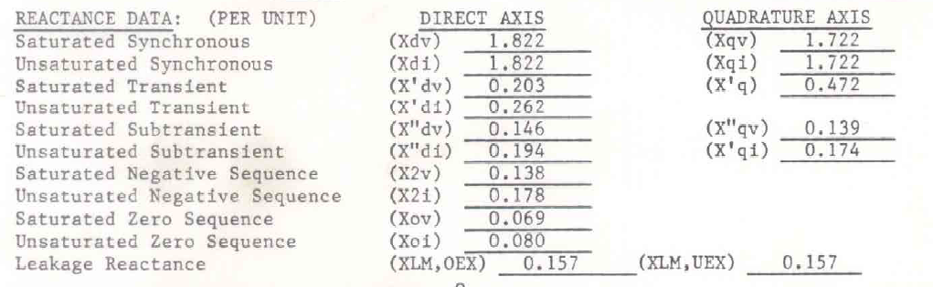
PU issue
A lot of attributes rely on external standards and these attributes are defined in PU in these standards:
Dynamics package, e.g. IEEE 421.5-2005 (for excitation systems, PSS, over/under excitation limiters, etc.)
Wind turbines/control – draft IEC 61400-27-1
Short circuit attributes that are based on IEC 60909
Manufacturers data is coming in pu (http://www.generatormart.com/data/power-generator/generatormart/200905012052266797/spec-sheet-1.pdf)
Notes:
34

Slide 35
ENTSO-E brief feedback on the HVDC modelling
The model seems to match the requirements for a proper dc model quite well. It is a good idea to model HVDC in CIM sufficient for operation, planning and dynamic studies and not for full transient studies.
Suggestion to outline a DC hub/junction.
Concern if all simulation tools will be able to support a dc model with this level of detail (for instance a general dc network topology).
There is a need of clarification for DC Xnodes: it is difficult to see what will belong to which MAS? What would you recommend to ENTSO-E
Short circuit calculations not covered: the HVDC model includes the converter transformer but does not model zero sequence data and grounding of the transformer. This will lead to errors in fault calculations for unsymmetrical faults if not included.
The following converter transformer data must be included in the DCPole data
Transformer nominal rating and voltage
Transformer impedances (positive/zero seq.)
Grounding connection
Notes:
35

Slide 36
ENTSO-E brief feedback on the HVDC modelling
Information of converter type: Voltage Source vs. Current Source controlled converters:
As far as we can see the only place where converter type is defined is through using the subtypes DCPoleCurrent and DCPoleVoltage. We think this information should be indicated on a higher level, example could be DCPoleConverterKind?
Multi-terminal and DC grid issues:
From the description in Figure 19, it seems that the necessary placeholders for classes are defined. One question is how measurements will be included, if DC switches (and protection) are included there will also be measurements. A second issue is that enough information is included for the load flow control in multi terminal topologies. The control setup in this document is based o point-to-point HVDC
Notes:
36

Slide 37
ENTSO-E brief feedback on the HVDC modelling
Differences between VSC and CCC converter models must also be handled correctly. From the document it seems as AC filters not are included in the HVDC model for CCC type (perhaps additional attributes are necessary in DCPoleCurrent). This could perhaps be more clearly defined in a figure.
Questions/other comments:
In the actual description is it possible to have a third terminal in the HVDC link ?
With ‘Current Source Converter’ you mean a technology type LCC (Line Commutating Converter) with thyristors?
Figures 5 and 6 are referred to type VSC (Voltage Source Control) but explanation in the paragraph are referred to type LCC.
At pages 21 and 22 there are 2 figures referred to Equipment: they are quite similar, but what is the right figure? (maybe the first?)
Is it right that parameters ‘ MaxModulationIndex‘ and ‘MaxValveCurrent’ are the same in type LCC and VSC? They are typical only of type VSC.
Notes:
37

Slide 38
ENTSO-E brief feedback on the HVDC modelling
Questions/other comments:
Is it right that parameters ‘ commutatingReactance‘ and ‘commutatingResistance’ are the same for type LCC and VSC? They are typical only of type LCC.
For the type LCC is it possible to introduce the restoring minimum angle? In this moment there is only ‘TargetAngle’ as reference.
The filters are not represented in the model
Is it possible to introduce the primary frequency regulation in HVDC model?
WG13 discussion on HVDC topic
Model DC topology model, but specify a specific DC topology as the only one allowed in 452.
For DC ties we would recommend having the DC tie in one model or the other or in both, but not split in the middle. It doesn’t work to break the DC network.
Lars will investigate reconfiguration of the DC bridges and whether the modeling needs to be changed to accommodate it.
Lars will update the proposal in Fig. 11 add DCLineSegment
Notes:
38

Slide 39
List of changes in IEC standards – 452, 456, etc
Do we have a list of changes applied between different releases of IEC standards? – including drafts; e.g. BusNameMarker is updated in CIM 16 – Is it included in 452; Will Petersen Coil be included?, etc
WG13 conclusion
Agreed to add BusNameMarker to 452.
Need to decide whether to add grounding classes (PetersenCoil, etc.) and auxilary equipment to 452.
Notes:
39

